Slide 1
Bachelor's thesis workflow suggestion
Mykyta Zaizzhai
10.3.25

Slide 2
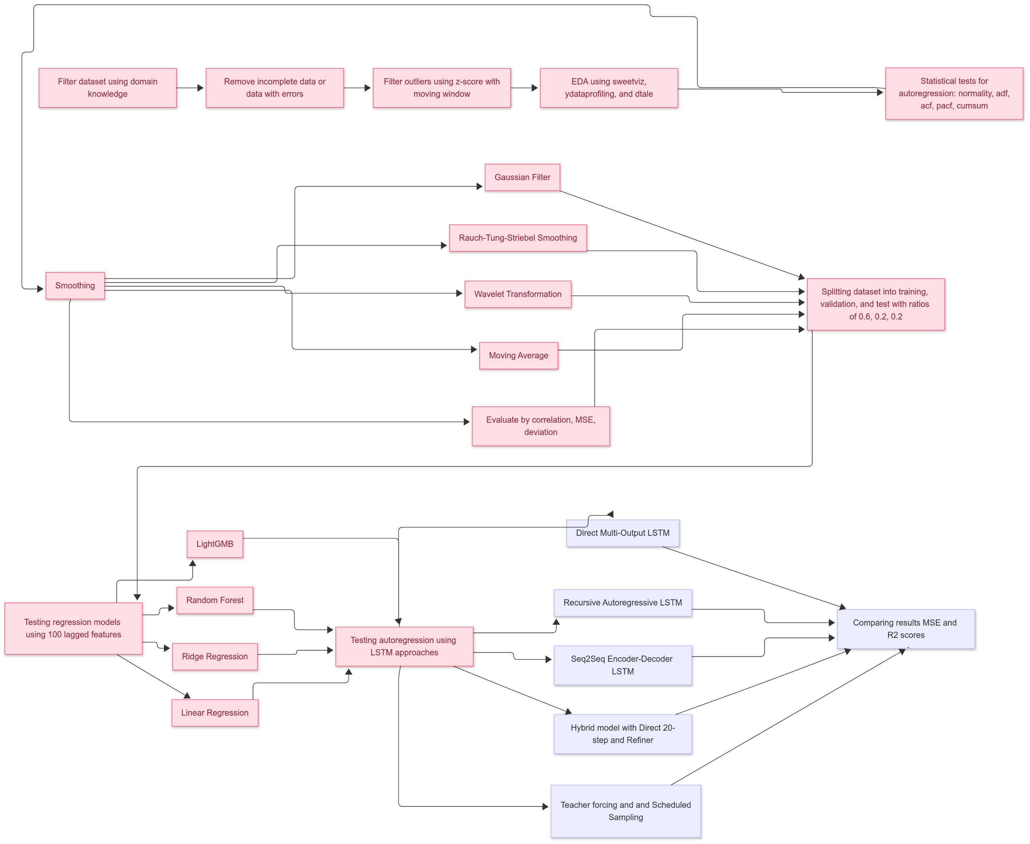
Red – ready in code
Blue – in work

Slide 3
1. Filter Dataset Using Domain Knowledge
• Remove irrelevant columns based on domain knowledge.
• Focus on features that are most likely to influence future values.
• Discard features that have no physical or statistical relation with the target variable.

Slide 4
2. Remove Incomplete Data or Data with Errors
• Dataset is large enough to avoid imputation.
• Identify missing values or erroneous entries that cannot be recovered.
• Clean data to ensure quality and consistency before analysis.

Slide 5
3. Filter Outliers Using Z-Score with moving widow
• Z-score is used to detect outliers in the dataset.
• A moving window approach is implemented to dynamically evaluate outliers to include different variance.
• Outliers can distort the model's performance, so they need to be filtered out.

Slide 6
4. Exploratory Data Analysis (EDA)
• Use Sweetviz, Ydataprofiling, and Dtale for detailed EDA.
• Generate visualizations to identify data patterns, distributions, and relationships.
• Use EDA to understand the underlying structure of the dataset before model building.

Slide 7
5. Statistical Tests for Autoregression
• Perform tests for normality, ADF (Augmented Dickey-Fuller), ACF (AutoCorrelation Function), PACF (Partial AutoCorrelation Function).
• Test for stationarity (important for time series forecasting).
• Cumulative Sum test (Cumsum) to check data trends.

Slide 8
6. Smoothing Methods Comparison
• Compare smoothing techniques: Moving Average (MA), Wavelet, RTS (Recursive Time Series), Gaussian Filter.
• Evaluate each method based on Correlation, MSE (Mean Squared Error), Deviation from original data, and time efficiency.
• Select the best method for smoothing based on the comparison.

Slide 9
7. Splitting Dataset
• Split the dataset into training (60%), validation (20%), and test (20%) sets.
• Ensure that the training data is large enough to train robust models.
• The validation set will be used for model tuning, and the test set will evaluate the final model.

Slide 10
8. Regression Testing (ML Models)
• Use lagged features as input and predict the 20th future value.
• Compare multiple regression models: Linear Regression (LR), Ridge Regression, Random Forest, and LightGBM.

Slide 11
9. Autoregression Using LSTM
• Implement various LSTM models for autoregressive forecasting:
1. Direct Multi-Output LSTM
2. Recursive Autoregressive LSTM (Step-by-Step Forecast)
3. Seq2Seq (Encoder-Decoder LSTM)
4. Hybrid Model: Direct 20-Value Sequence+ Refiner Model for the 20th value. //makes sense?
5. Teacher forcing and schedule sampling - //want to try, seems interesting, needs to be added in theory

Slide 12
Direct Multi-Output LSTM
[y_{t-100,} y_{t-99 . . .} y_{t-1} ]
LSTM
[y_pred_{1,} y_pred_{2 . . .} y_pred₂₀ ]
input
model
output

Slide 13
Recursive Autoregressive LSTM
[y_{t-100,} y_{t-99 . . .} y_{t-1} ]
LSTM
[y_pred_{n}]
input
model
output
[ y_{t-100-n . . .} y_{t-n,} y_pred_{n-1,} y_pred_{n}]
LSTM
[y_pred_{n+1}]
new input
same model
next output

Slide 14
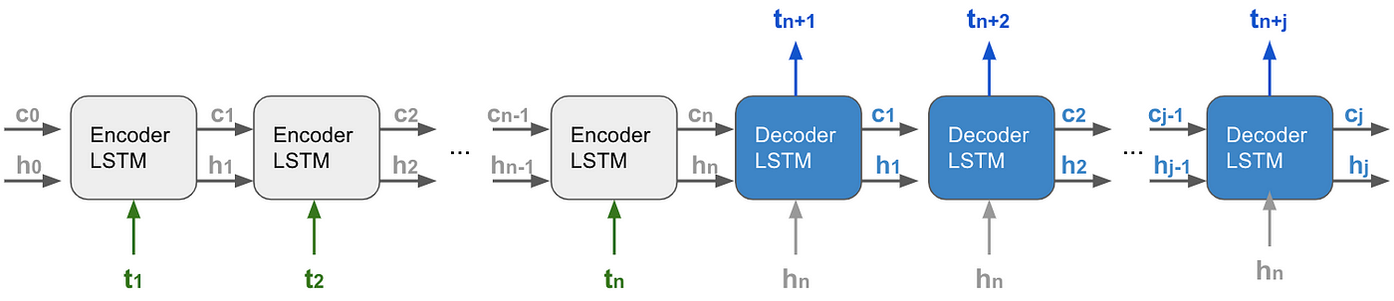
Seq2seq model

Slide 15
Hybrid model
[y_{t-100,} y_{t-99 . . .} y_{t-1} ]
LSTM_1
[y_pred_{1,} y_pred_{2 . . .} y_pred₂₀ ]
input
model_1
model_1 output
LSTM_2 or another model
[y_pred₂₀]
model_2
model_2 output

Slide 16
10. Comparison of the results
• Evaluate models using performance metrics such as MSE (Mean Squared Error), R² ,time, etc...

